Slide 1

Student Attendance Tracker
An app to record and monitor student attendance, generate reports, and send notifications for absences
Notes:
NOTE:
To change the image on this slide, select the picture and delete it. Then click the Pictures icon in the placeholder to insert your own image.

Slide 2

Table of Contents
Introduction
Key Process of the Application
Functionality of the Application
Key Features
Impact of the Application
Benefits of the Application
Improvements to the Application
Conclusion
Q & A

Slide 3
Introduction
Identification of the Problem:
Managing student attendance is often manual, time-consuming, and prone to errors.
Lack of real-time notifications about student absences leads to poor engagement and accountability.
Solution to the problem:
Introduce the app as a digital solution to simplify and automate attendance management.

Slide 4
Key Process of the Application
Step 1
Log into the App by entering the relevant Information
(Name & NIC)
Step 2
Mark
the Attendance
Step 3
Record
the Attendance

Slide 5
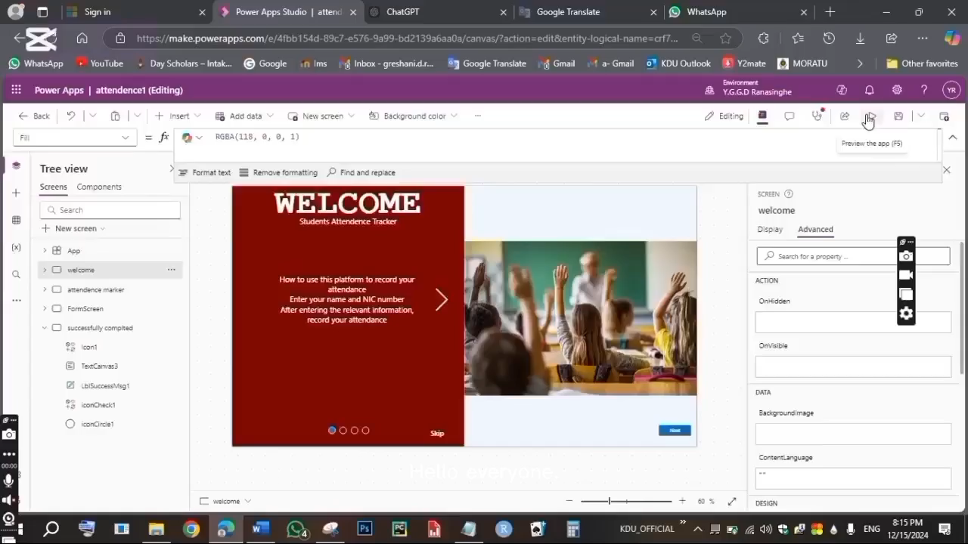
Functionality of the Application

Slide 6


Key Features – Tools Used
Power Apps Microsoft Excel

Slide 7

Impact of the Application
Real-time tracking of attendance ensures better communication between educators and parents.
Enables data-driven decisions for interventions on attendance issues.
Addresses scalability issues for large institutions.

Slide 8

Benefits of the Application
For Educators:
Saves time and reduces paperwork.
Access to actionable insights on attendance patterns.
For Parents:
Real-time updates on student attendance.
Encourages better student accountability.
For Institutions:
Improved record-keeping and compliance.
Scalability to handle multiple classes or campuses.

Slide 9

Improvements to the Application
Feedback Mechanism:
Add options for students/parents to provide reasons for absences directly through the app.
Integration:
Sync with Learning Management Systems (LMS) for centralized data.
AI Insights:
Predict students at risk of poor performance based on attendance trends.

Slide 10
Conclusion
The Student Attendance Tracker App, built using Power Apps, streamlines attendance management by providing an efficient, user-friendly platform for educators.
It enables real-time monitoring, generates actionable insights through reports, and enhances communication by sending timely notifications for absences.
By automating routine processes, this app not only saves time but also improves accountability and fosters stronger collaboration between educators and parents.
With its scalability and potential for future enhancements, this app is a valuable tool for modernizing student attendance tracking.

Slide 11

Q & A

Slide 12

Thank You
BSc in Applied Data Science Communication
Intake 40
Advanced SQL & Cloud Databases
( LB 2224 )

